Slide 1
A Case Study on How Central Processing Unit has evolved Over the years & How powerful is it going to get in future

Slide 2
Main Points that will be covered in the Case Study
How it’s made (Until and Unless we know how something is made we can’t precisely admire the beauty of it and how it has impacted the whole world with it.
The Exponential Increase in Power ( This part will have a lot of data from over the year about how it has exponentially increased its power to computer and what is the current state of CPU.
Today’s CPU Architecture ( We will discuss what is the architecture of today’s CPU)
Some of the Big Names that are involved in evolution of CPUs

Slide 3
Main Points that will be covered in the Case Study
Future of Computing / CPU (Quantum Computing, Graphene Computers, etc)
Moore’s law and two equations allow to explain the main trends of CPU evolution since MOS technologies have been used to implement microprocessors
A Timeline of what has been happening in CPU industry.
Conclusion The future requires more targeted processing, optimization and differentiation in the design process for systems that contain different types of processor, while supporting the requirements of the software ecosystem. Energy efficiency is the key differentiator in the world of processing and will be the key driver for the future of computing. Anyone who ignores this evolution will simply get left behind.

Slide 4
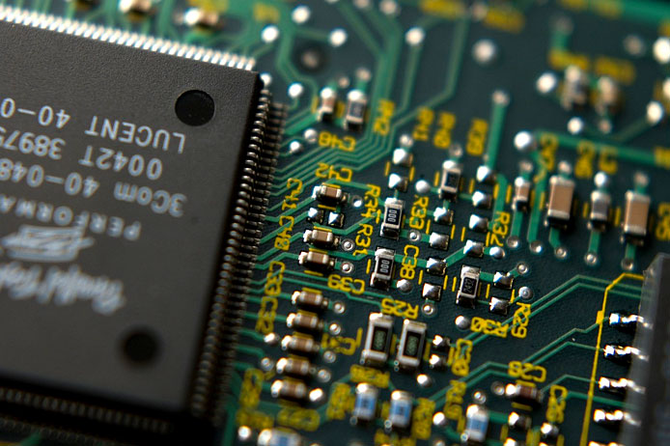
Main Points that will be covered in the Case Study
One thing is clear — the CPU won’t be the way it used to be. It isn’t going to be just better, it’s going to be different. When it comes to modern technology, time flies really fast. If you think about the central processing unit, you’ll probably imagine one of AMD or Intel’s creations

Slide 5
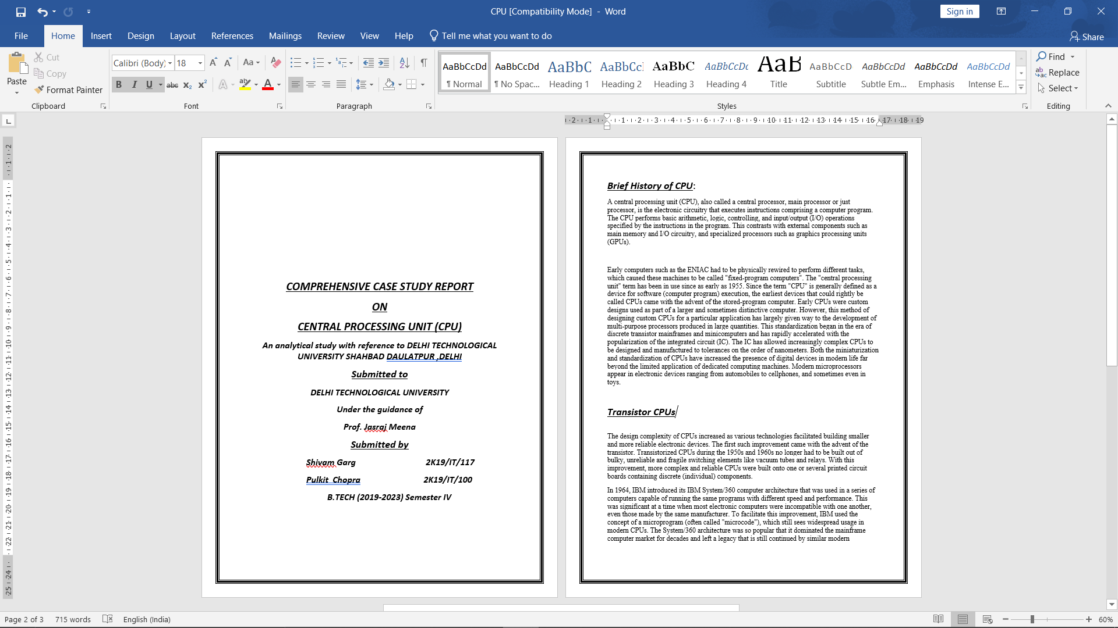
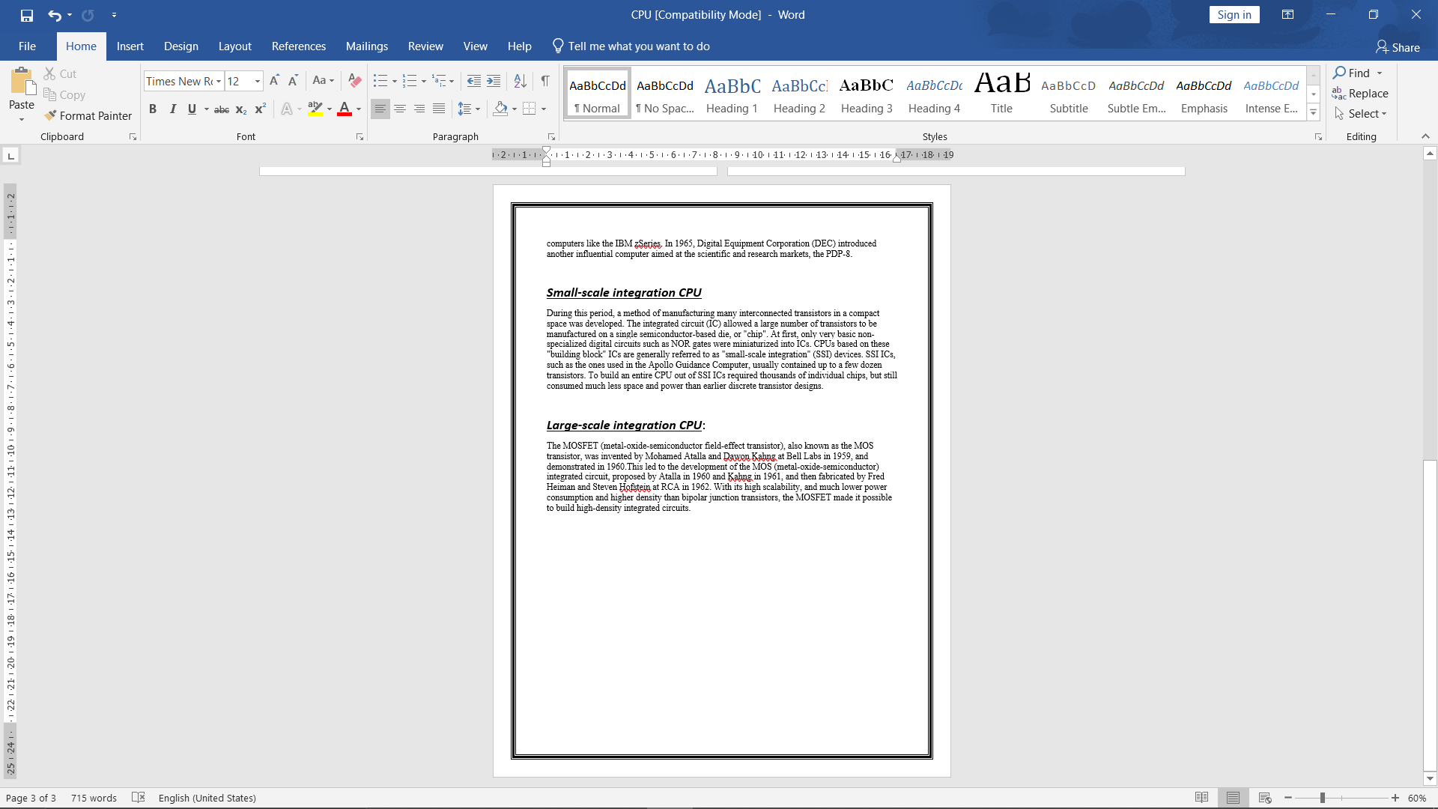
Works done So Far
Written about brief History of CPUs
Transistor CPUs
Small-scale integration CPU
Large-scale integration CPU

Slide 6
References
https://www.fluxmagazine.com/evolution-of-cpu-future-of-processors (Flux Magazine)
45-year CPU evolution: one law and two equations by Daniel Etiemble
https://www.computerhope.com/history/processor.html
https://www.newelectronics.co.uk/electronics-technology/the-evolution-of-the-microprocessor-from-single-cpus-to-many-core-devices/35556/
https://en.wikipedia.org/wiki/Central_processing_unit (Wikipedia)
Times Magazine’s article on CPU

Slide 7


